Slide 1
Liquid rescale of images
Team 17
Tanishq Jain
2021294

Slide 2
Introduction
Liquid rescaling (Seam carving) is an algorithm for content-aware image resizing. It uses an energy function which defines the importance of pixels. A seam is a connected path of low energy pixels across the image. Hence, the algorithm removes (inserts) seams successively to reduce (extend) the size of image.
The variety of display devices today imposes new demands on digital media. We need an algorithm to resize images without distorting their content. There are limitations to simple operations:
Scaling can’t modify the aspect ratio effectively.
Cropping can only remove pixels from the boundaries.

Slide 3
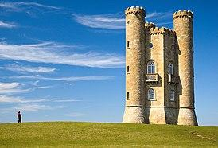
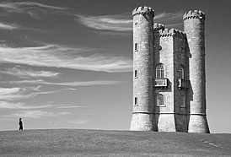
Setup
Given the RGB values for a pixel, intensity is calculated using Luminosity method:
𝐼𝑛𝑡𝑒𝑛𝑠𝑖𝑡𝑦, 𝐼 = 0.3 ∗ 𝑅 + 0.59 ∗ 𝐺 + 0.11 ∗ 𝐵
Energy is computed as the 2-norm of intensity gradient for the pixel:
A vertical seam can be defined as:
Basically, it is an 8-connected path of pixels from top to bottom, containing one pixel in each row.

Slide 4
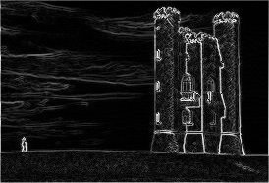
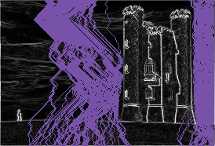
Suppose we have to find the optimal vertical seam. We setup a cost matrix using DP. For any pixel, it stores the value of minimum cumulative energy out of all seams arriving at that pixel from the top. Recurrence relation is:
Base case: Cost is equal to energy of pixel for all pixels in the top row.
Now, optimal seam (with lowest cost) can be constructed by backtracking from the last row.

Slide 5
Seam removal
Using the defined setup, we can implement seam removal as the following process.
Set energy matrix (using intensity matrix).
Set cost matrix (using energy matrix).
Compute optimal seam (using cost matrix).
Remove seam from the intensity matrix.

Slide 6
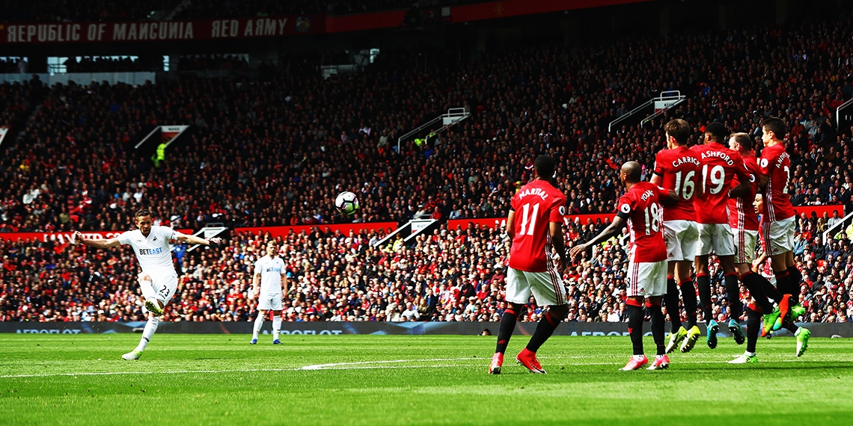
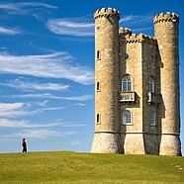
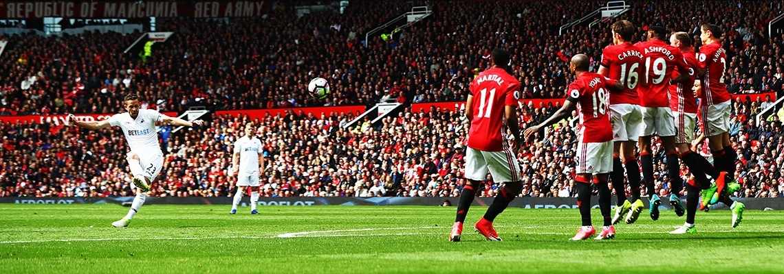

Slide 7
Seam insertion
For seam insertion, we approximate inverting the seam removal process. But that can create uneven stretching by choosing the same seam repeatedly. Hence, for effective enlarging, we insert k seams in a single go.
Steps are:
Create a copy of the intensity matrix.
Simulate seam removal k times on this matrix.
Mark the pixels removed in these operations.
Duplicate the marked pixels in the original intensity matrix.

Slide 8
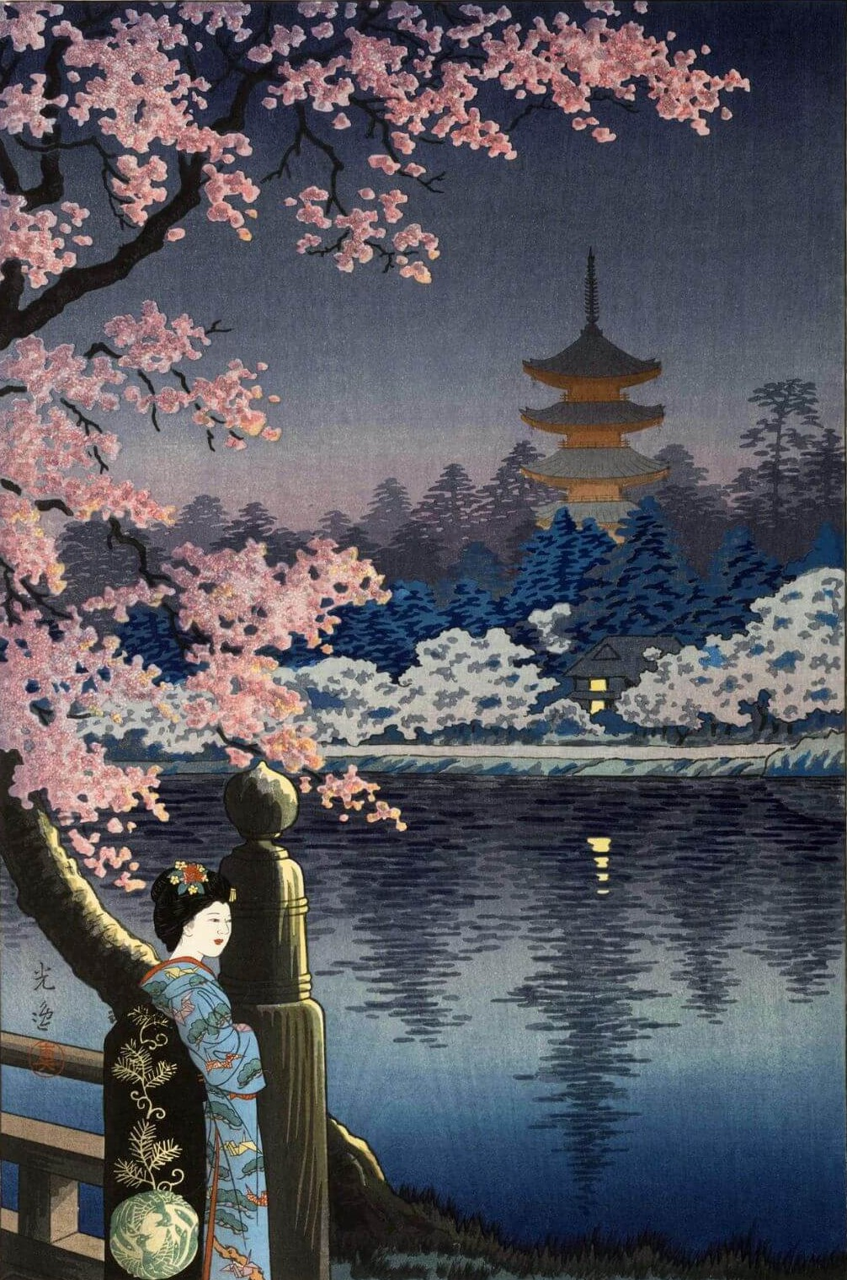

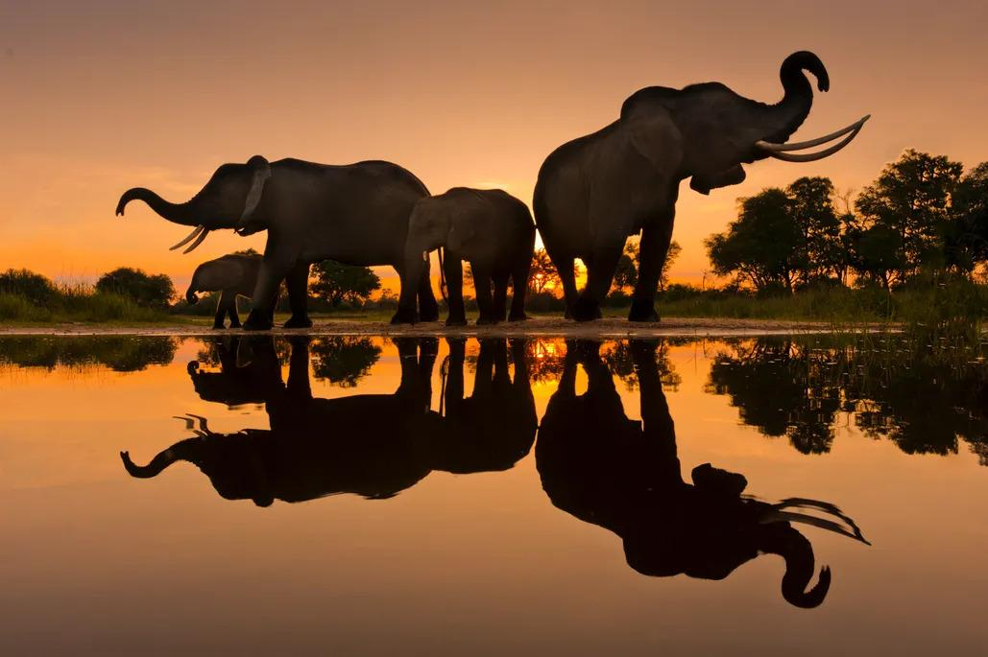

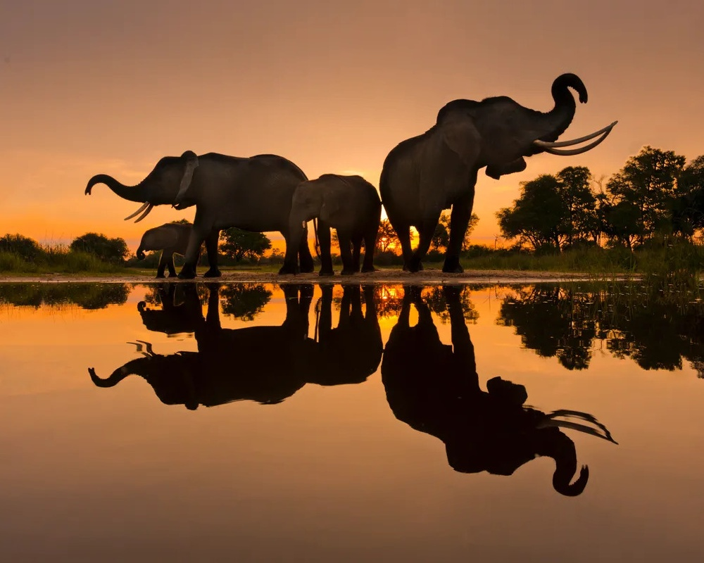
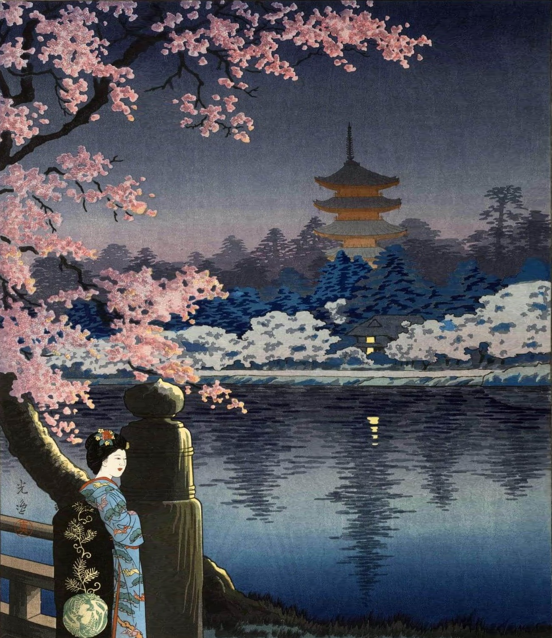

Slide 9
Optimal order retargeting
It can be used when both width and height need to be reduced. The aim is to find the optimal order for vertical, horizontal seam removals such that total cost of removed seams is minimized.
It involves setting up a 2D DP and a bitmap. T[r][c] stores the optimal cost of reducing height, and width by r, c respectively. It also stores the intensity matrix at that state.
We also maintain a bitmap to track next choice at each state. It can be used to recover the optimal order of seam operations. Recurrence relation is:
Base case is T[0][0] = 0 and corresponds to original intensity matrix.

Slide 10
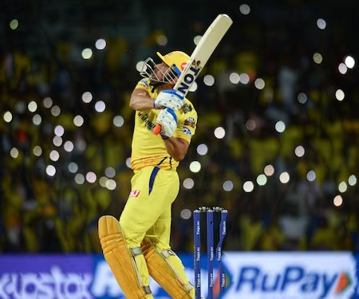
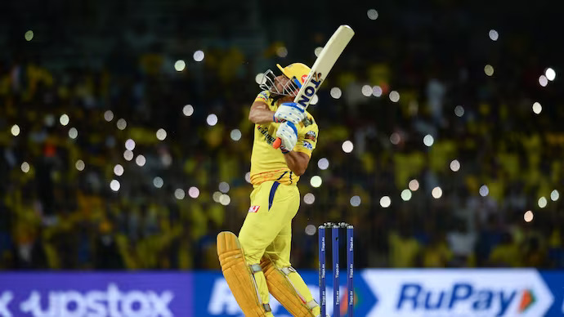

Optimal order image re-targeting involves more computation and takes significantly more time. Furthermore, it was observed that the outputs are largely indistinguishable from outputs using simple retargeting.
Can you distinguish between the two outputs?

Slide 11
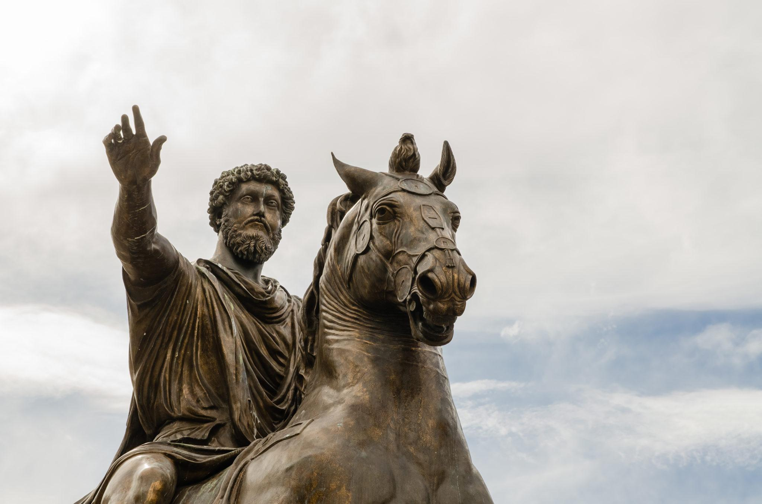
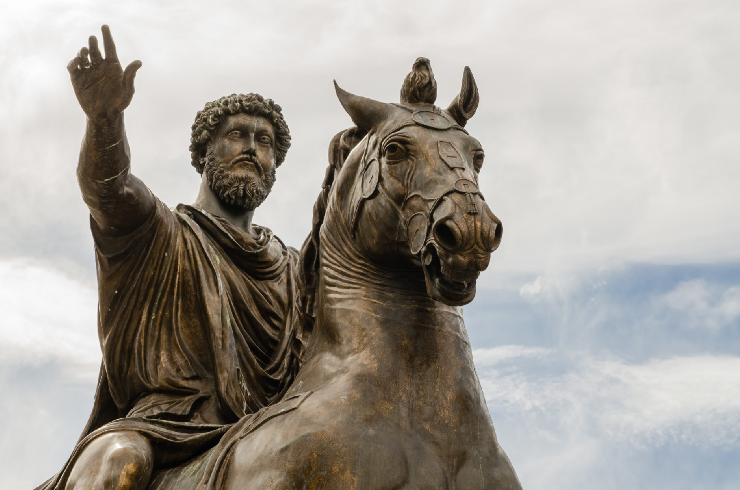
Content amplification
Content amplification is achieved by combining seam carving with standard scaling. First, the image is scaled uniformly by a scaling factor. Then, seam carving is used in both directions to restore the original size of the image. This results in an amplification of the content rich zones in the image.

Slide 12
Object removal
The user marks the region to be removed using a specific color in the input image. A modified version of seam removal is used to achieve the goal.
Set energy matrix.
For marked pixels, update energy to a large -ve value (to incentivize removal).
Set cost matrix.
Compute optimal seam.
Remove seam from the intensity matrix.
This removes the marked pixels but reduces the size of image. Now we use seam insertion to restore the original size of the image.

Slide 13
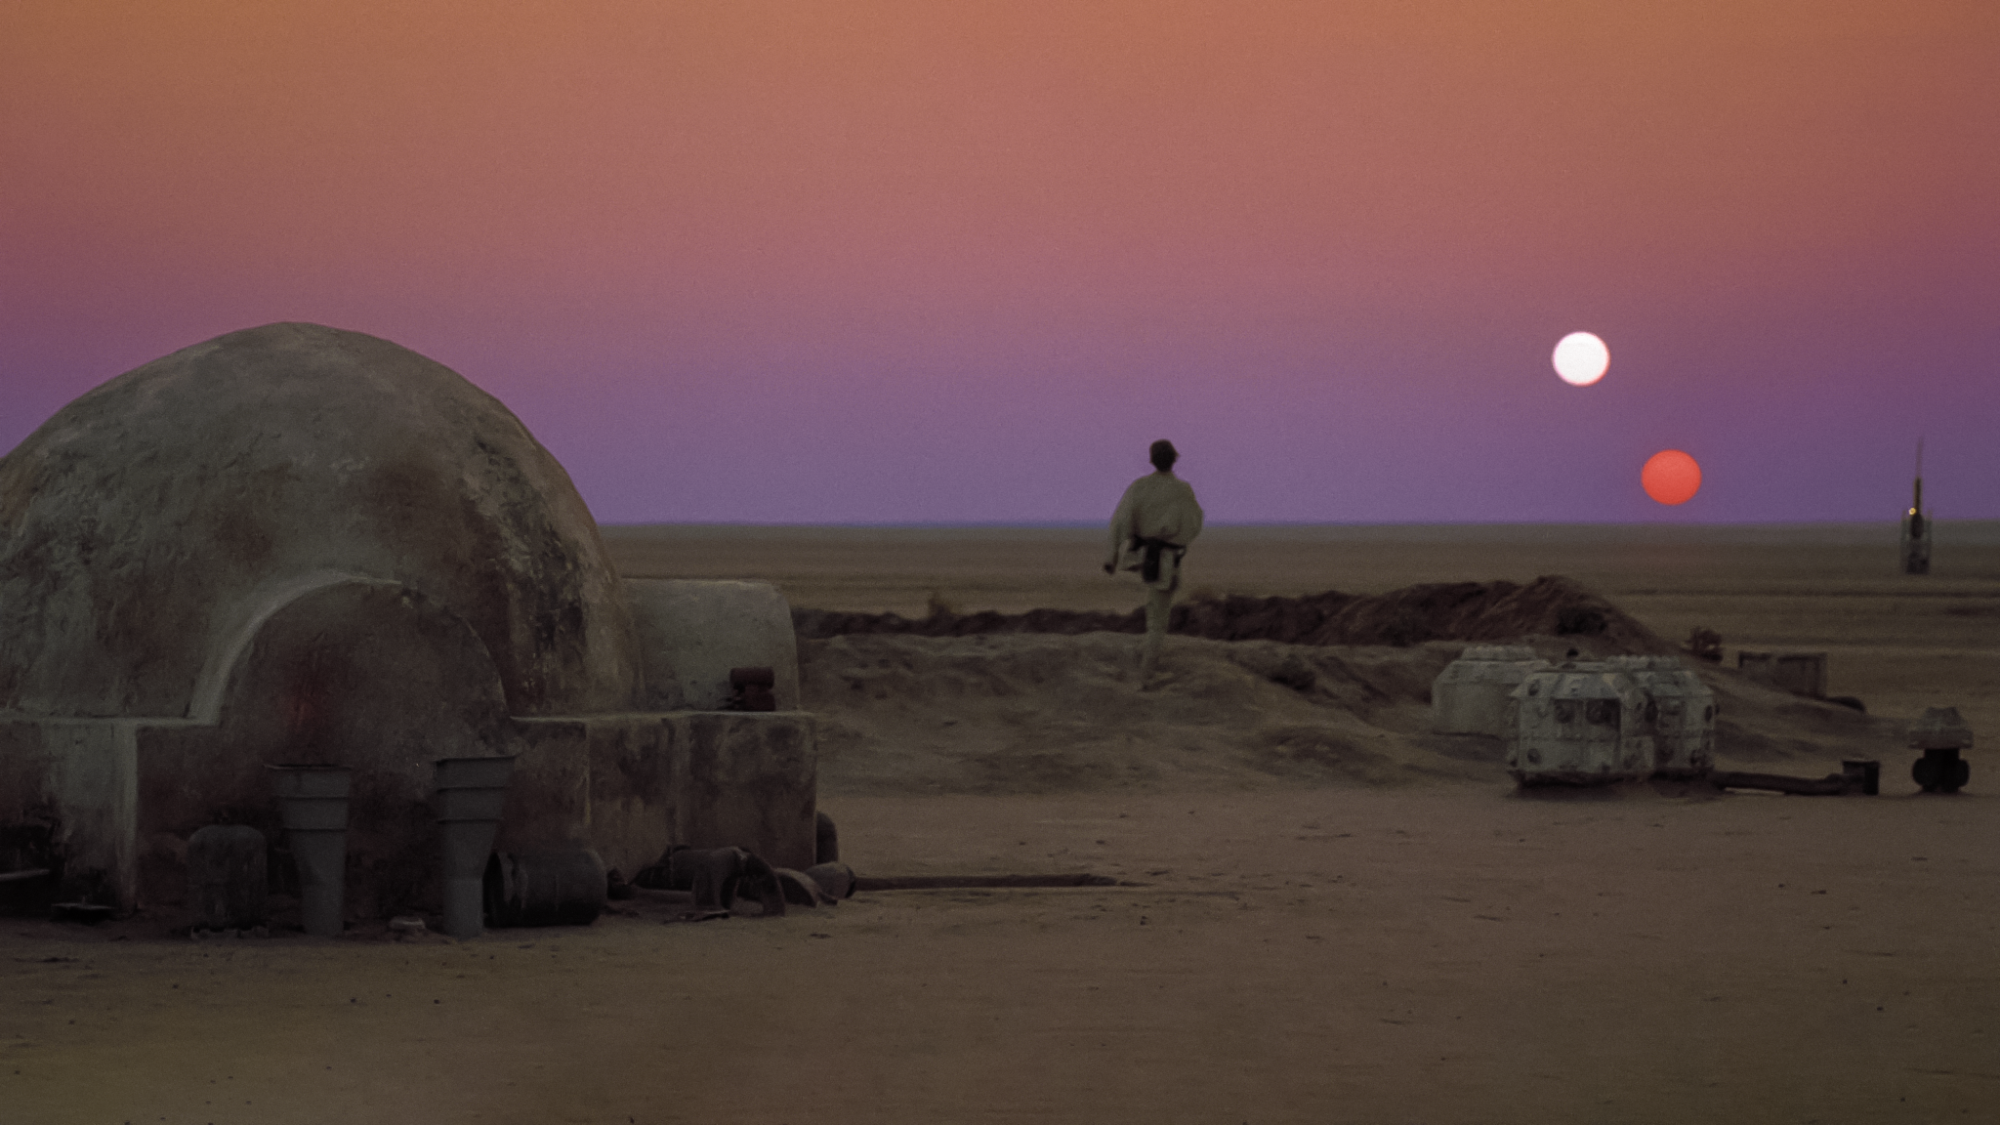
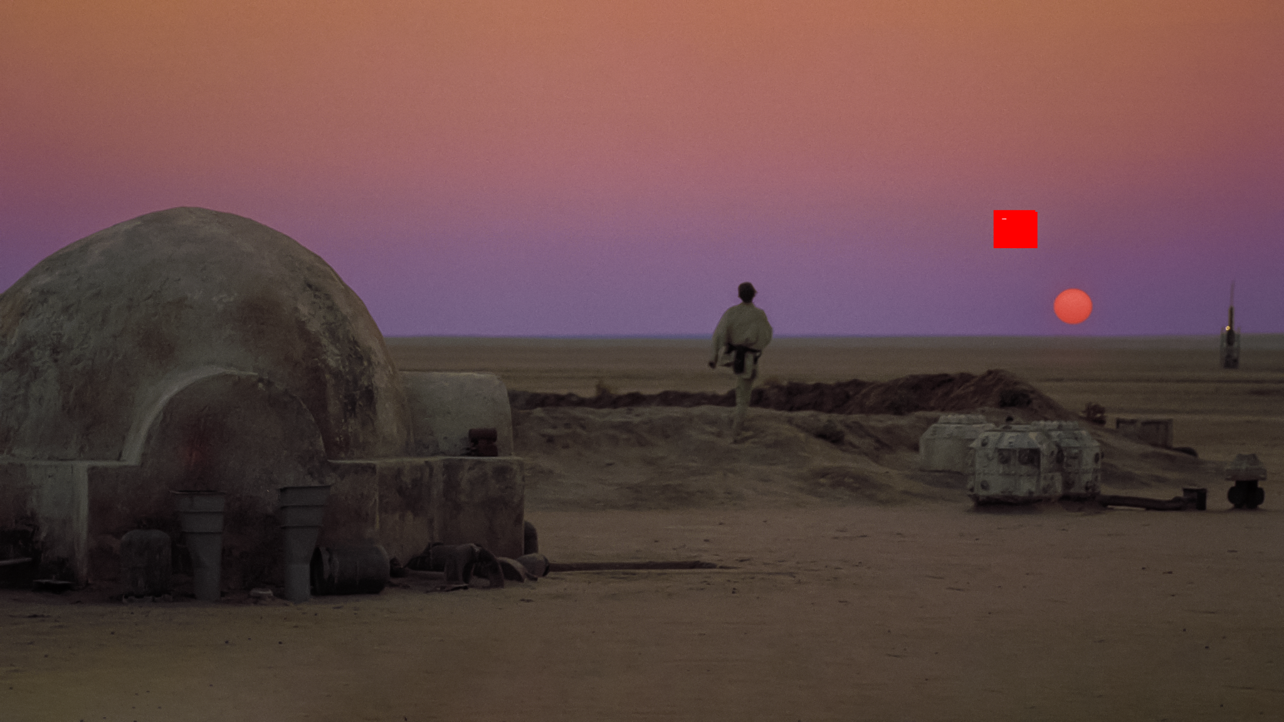
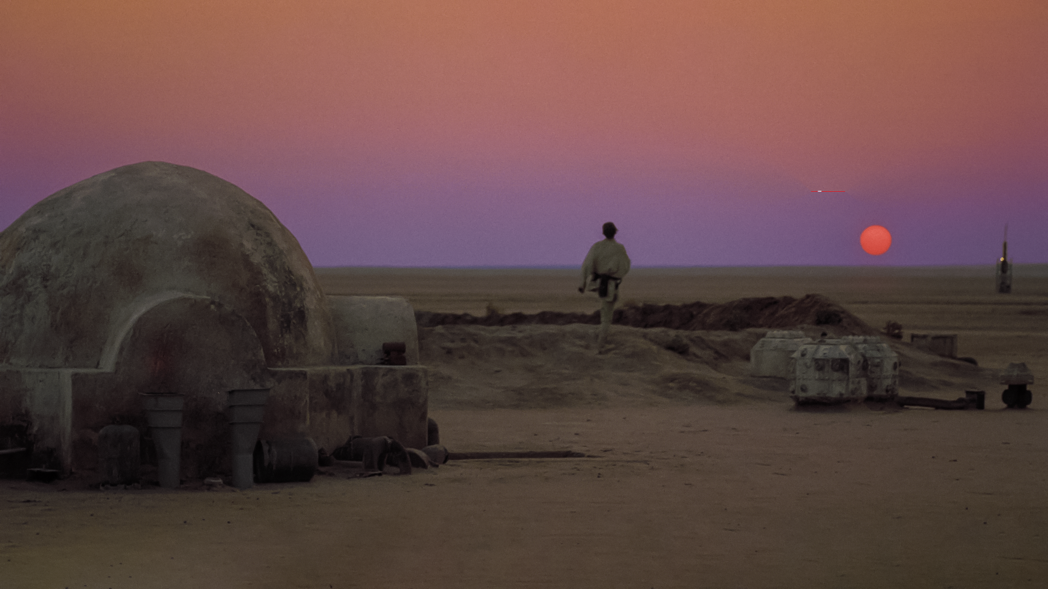
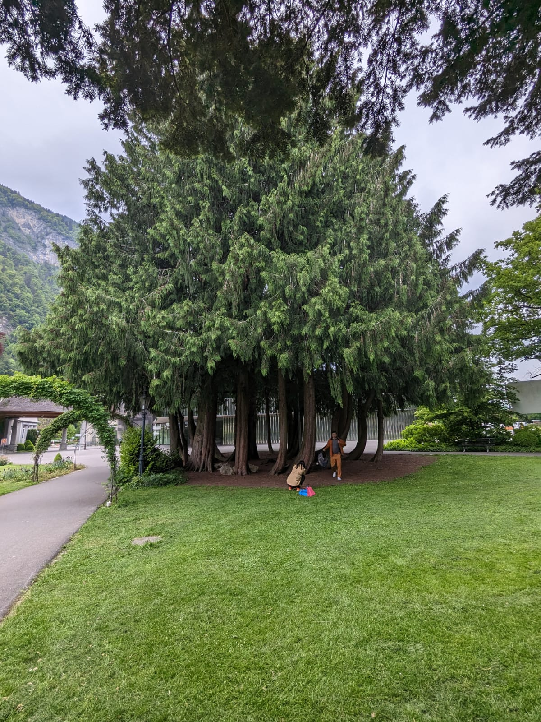
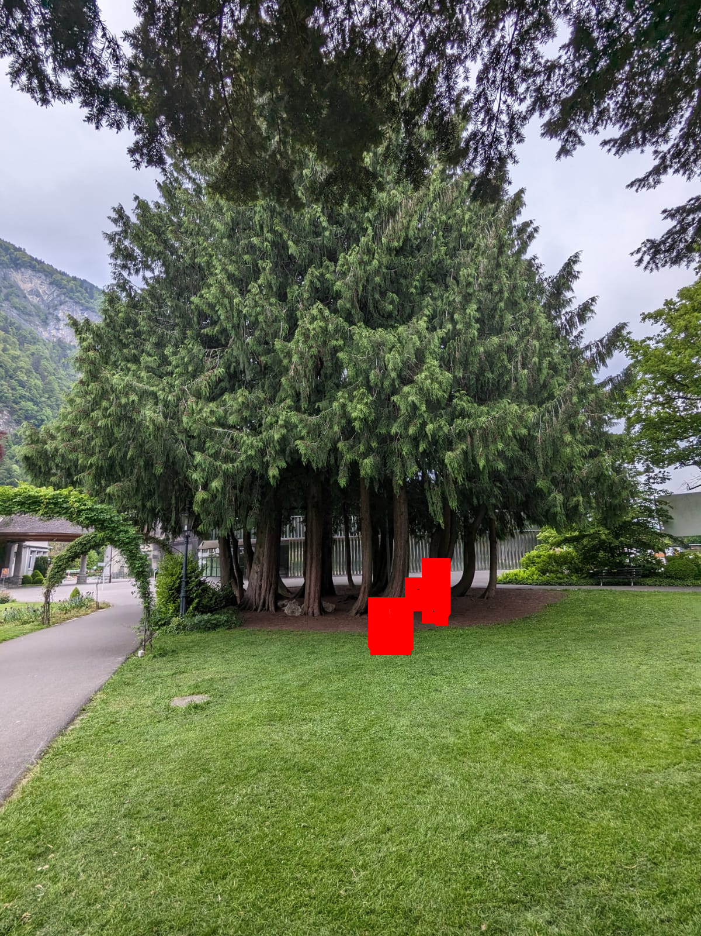
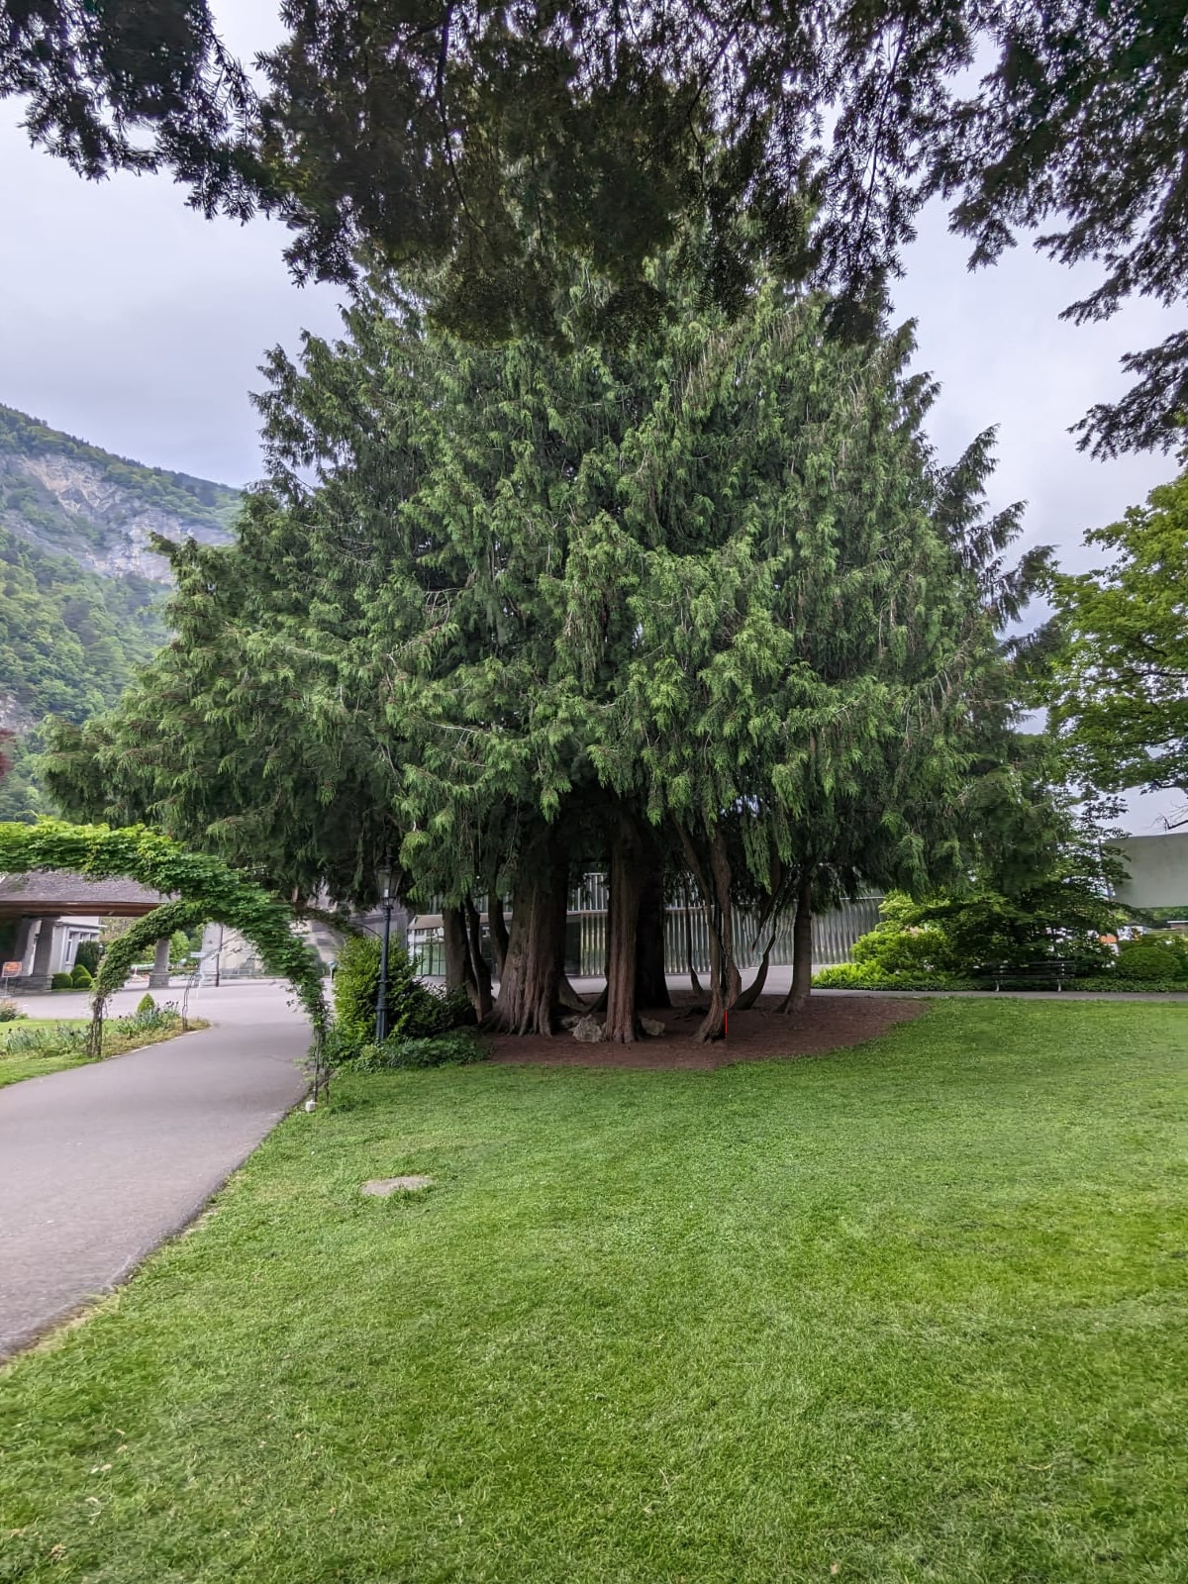

Slide 14
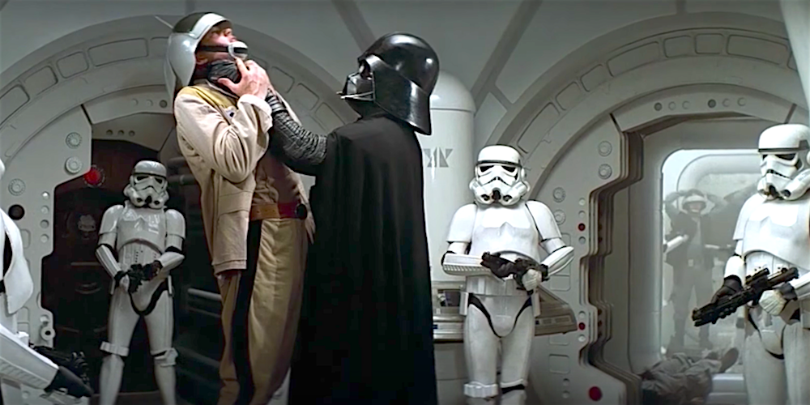
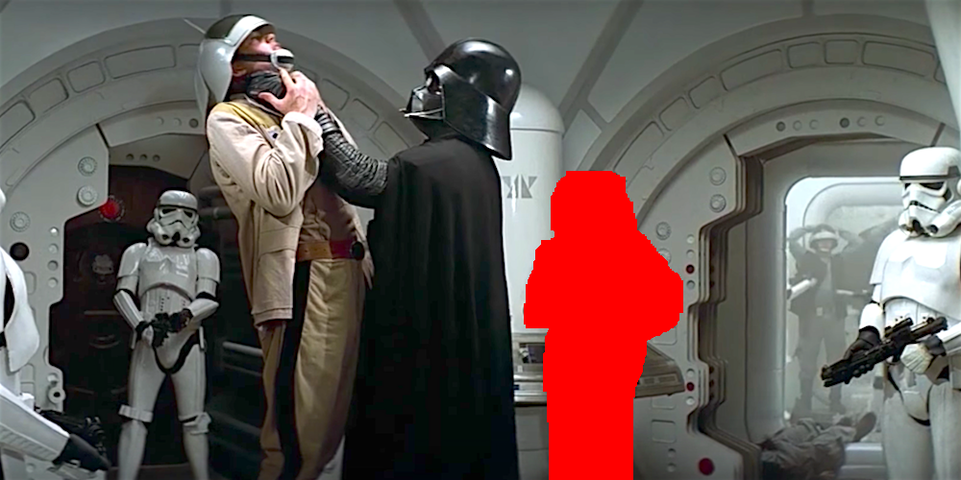
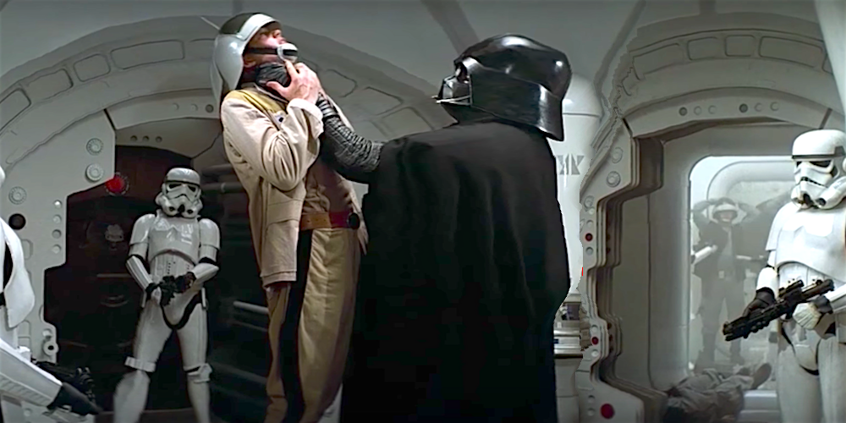
However, a limitation was observed. The algorithm may not perform well in crowded images, or when we try to remove a major portion of the image.

Slide 15
Multi-size images
Idea - Image retargeting using seam operations is not feasible in real time. For web application, if we could somehow encode information to resize to any dimensions?
Approach - We input maximum supported dimensions for the image. Use simple retargeting to achieve the largest supported image. Now, perform seam removals (in a single direction) until all seams have been removed. During this process, track the index of the seam removing any given pixel. Finally, write this information of seam indices into a text file to enable the multi-size image functionality.

